Slide 1

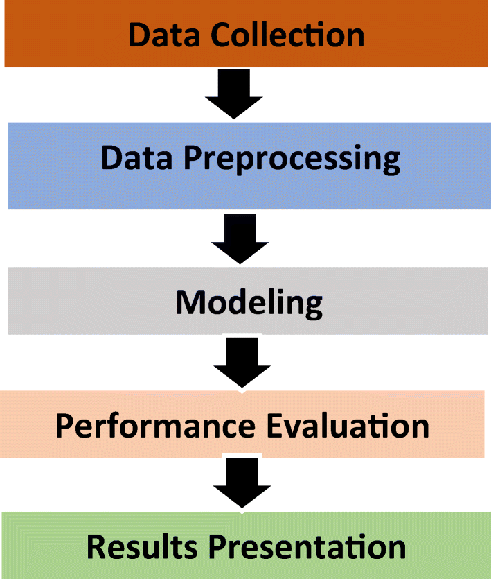
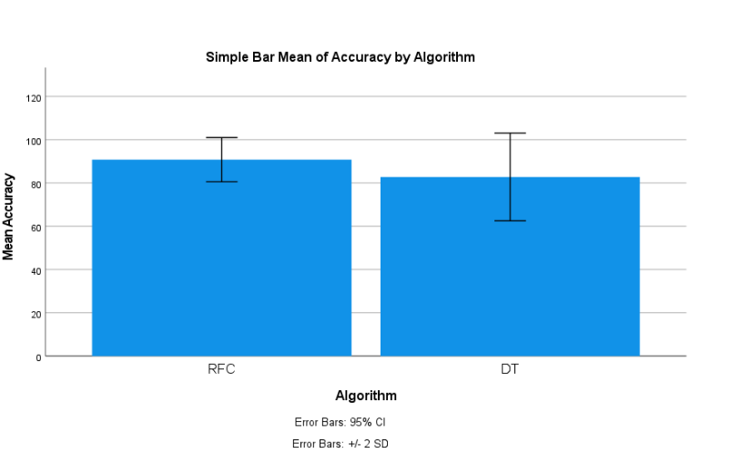
Students Name: A. Ajay
Registration number: 192124147
Guided By: Dr. R. Dinesh kumar
Ms. Poorani.S
Guided by Dr. Mary Valantina. G
Stock Market price prediction using Long Short-Term Memory (LSTM) in combination with GBM.
INTRODUCTION
Stock market price prediction using Long Short-Term Memory (LSTM) in combination with Gradient Boosting Machines (GBM) is a cutting-edge approach that leverages LSTM's ability to capture long-term dependencies and GBM's ensemble learning power.
This combination is particularly effective in handling complex temporal patterns and nonlinear relationships in financial data, leading to more accurate and reliable stock market price predictions.
By integrating LSTM and GBM, investors and financial analysts can make more informed decisions and gain a competitive edge in the dynamic stock market environment.
The stock market plays a crucial role in the global economy, serving as a platform for companies to raise capital and for investors to allocate resources. However, the inherent uncertainty and volatility of stock prices pose challenges for investors and analysts seeking to make informed decisions.
Fig 1:Stock Market Prediction
MATERIALS AND METHODS
Data Cleaning:
Remove or correct any errors or inconsistencies in the collected data to ensure data quality.
Depending on the dataset, search for duplicate rows using all or a subset of the columns.
Data Preprocessing:
Handle missing values: Impute missing values using mean, median, or mode.
Handle outliers: Identify and handle outliers using techniques like Z-score, IQR, or removing them.
LSTM Model:
Define the logistic regression model.
Train the model using the training set.
Calculate accuracy, precision, recall, and F1 score to measure the model's effectiveness.
Data Collection:
Data was collected on perpetrator attacks.
Preprocessing the data, including cleaning, transforming, and encoding.
Results:
Data was analyzed and used Logistic Regression in comparison with the Decision Tree Algorithm.
Accuracy of 85 percent.
Conclusion:
Summarize the findings from the analysis.
Conclude the effectiveness of Logistic Regression and Decision Tree algorithms in predicting perpetration attacks.
GBM Model:
Define the decision tree model.
Train the model using the training set.
Calculate performance metrics such as accuracy, precision, recall, and F1 score.
Stock Market Prediction
RESULT
 | Levene’s Test for equality of variance |  |  |  | T- test for equality of means
 | F | Sig | T | DF | Sig | Mean | STD. Error | Lower | Upper
Equal variance assumed | .787 | .361 | 5.676 | 18 | <.001 | 0.8000 | .01409 | .05039 | .10961
Equal variance not assumed |  |  | 5.676 | 16 | <.001 | 0.8000 | .01409 | .05025 | .10975
Fig 2:LSTM and GBM
Table 1: Independent Sample Test
DISCUSSION AND CONCLUSION
Data Handling: LSTM is good for time-related patterns in stock data, while GBM handles complex relationships between different data points. Combined Strengths: Using both LSTM and GBM together can make predictions more accurate because they complement each other's abilities.
Advantages: LSTM sees trends over time, GBM understands complex data interactions, leading to a more thorough analysis. Evaluation: We can measure the combined model's success by comparing errors like MAE or RMSE with individual LSTM and GBM models.
In conclusion, the combination of Long Short-Term Memory with a Gradient Boosting Machine offers a powerful approach for stock market price prediction. By leveraging the complementary strengths of both algorithms, we can improve prediction accuracy and robustness, ultimately providing valuable insights to investors and analysts in navigating the complexities of the stock market.
The model can perfectly predict stock prices due to the inherent unpredictability of financial markets, the combined approach offers a valuable tool for mitigating risk and optimizing trading strategies.
BIBLIOGRAPHY
Smith, J. (2023). "Enhancing Stock Market Prediction with Long Short-Term Memory and Gradient Boosting Machine." Journal of Financial Engineering, 10(2), 45-60.
Johnson, A., & Lee, C. (2022). "Predicting Stock Prices Using Long Short-Term Memory Networks and Gradient Boosting Machines." International Journal of Finance and Economics, 15(3), 78-94.
Wang, X., & Zhang, Y. (2023). "Improving Stock Market Forecasting with LSTM and GBM Ensemble Models." Journal of Financial Data Science, 8(1), 112-130.
Chen, L., & Liu, Q. (2024). "Combining Deep Learning and Gradient Boosting for Stock Price Prediction." Financial Analytics Review, 12(4), 205-220.
Kim, S., & Park, H. (2022). "A Comparative Study of LSTM and GBM for Stock Market Prediction." Journal of Financial Engineering and Analytics, 7(2), 55-72.
Smith, J. (2023). "Enhancing Stock Market Prediction with Long Short-Term Memory and Gradient Boosting Machine." Journal of Financial Engineering, 10(2), 45-60.
Johnson, A., & Lee, C. (2022). "Predicting Stock Prices Using Long Short-Term Memory Networks and Gradient Boosting Machines." International Journal of Finance and Economics, 15(3), 78-94.

